Slide 1
WP 7 - Sustainability
November 5th, 2019
Authors:
Ornela De Giacomo, Jana Kolar, Roberto Pugliese, Dario Roccella - CERIC-ERIC

Slide 2
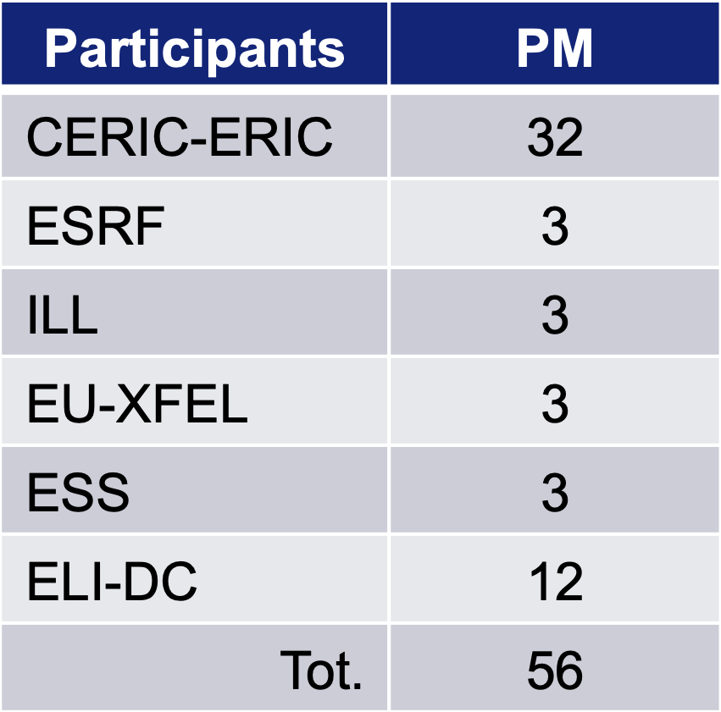
Participants / effort / critical aspects
The connection with the stakeholders and the collection of their feedback is a critical aspect of the work package.

Slide 3
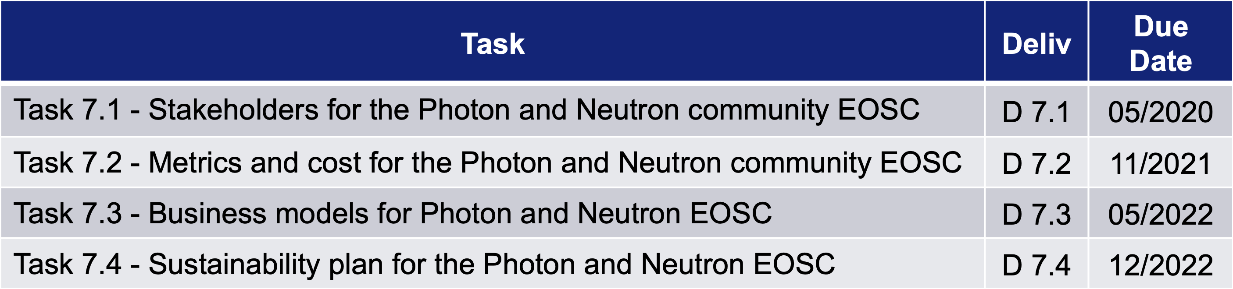
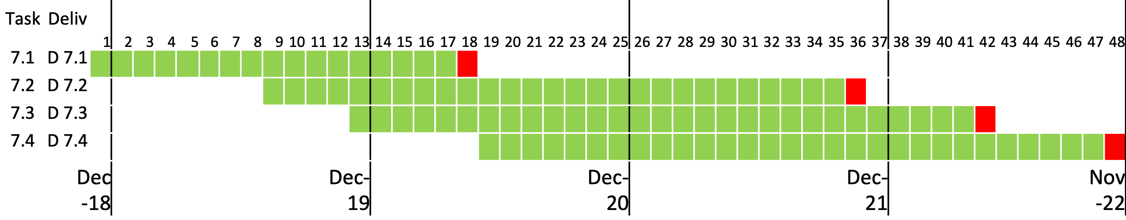
Tasks and deliverables

Slide 4
WP7 – Sustainability: Status (1/2)
Task 7.1 Stakeholders for the Photon and Neutron community EOSC [M1,18]
The database of stakeholders will be used to involved stakeholders and get feedback via targeted questionnaires and interviews. The feedback from stakeholders will allow us to address the other tasks
MS 7.1 List of stakeholders (05/2019) – OK
Operational version of the database -> Nov 2019
Definition of survey platform -> Dec 2019
D 7.1 : Stakeholders for Photon and Neutron Community EOSC (Report, 05/2020) – Currently in preparation

Slide 5
Stakehoder database: stakeholder types
Data/Research Initiatives
Cloud providers
Research funding organisations
Other clusters and multi facility partners
Users, Research Communities and Institutions
Other European projects related to the EOSC
European Research Infrastructures (ERIs)
National Research Infrastructures (NRIs)
Non-European Research Infrastructures (NERIs)
E-Infrastructures
RIs shareholders and funding bodies
Policy makers
Publishers
ICT Industry, Industry associations and technology providers

Slide 6
WP7 – Sustainability: Status (2/2)
Task 7.2 Metrics and cost for the Photon and Neutron community EOSC [M9-36]
Analysis and development of a cost model and of metrics for the evaluation added value of the services provided to the community
We are currently working at the development of an auditable cost model and
to the definition and selection of suitable metrics to evaluate the added value of services
which will be computed by tools like PUMA, VUO and others.

Slide 7
List of internal milestones (1/2)
It’s an iterative process (Deming Cycle: Plan-Do-Check-Adapt) …
Operational version of the database -> Nov 2019
Definition of survey platform -> Dec 2019
Consultation with partners and other RIs to define costs and metrics to evaluate added value -> Mar 2020
D 7.1 : Photon and Neutron EOSC Stakeholder Feedback (Report, 05/2020)
Feedback from stakeholders on cost model and metrics -> Jul 2020
Development of the first version of cost model and metrics, considering the feedback from stakeholders -> Dec 2020
Refinement of the metrics, according to the stakeholders consultation and first implementations -> Oct 2021
D 7.2 : Photon and Neutron EOSC metrics and costs model (Report, 11/2021)

Slide 8
List of internal milestones (2/2)
Analysis of the survey on PaNOSC business model with stakeholders -> Jan 2021 [M14]
Development of the first draft business model -> June 2021
Refinement of the business model and development of the funding model -> March 2022
D 7.3 : Photon and Neutron EOSC Business model reference document (Report, 05/2022)
Analysis of the consultation with stakeholders on sustainability plan -> Jan 2021 [M20]
Development of the outline of the sustainability plan -> June 2021
Development of the full sustainability plan -> June 2022
Final version of the sustainability plan -> Nov 2022
D 7.4 : Photon and Neutron EOSC Sustainability plan (Report, 12/2022)

Slide 9
Auditable costs of the PaNOSC
How can be compute the costs of the PaNOSC?
We have to count cost for bulding the PaNOSC
We have to count cost to maintain the PaNOSC
We have to count cost to renew the PaNOSC
We have to separate cost for hardware, consumables, travels, personnel.
Costs depend also on the specific data policy (WP2)
Factors that influence sustainability
Maintenance factor: Support contracts (0,15?)
Hardware depreciation: Depreciation of infrastructure (0,2?)
Update factor: Moore Law + Data Policy (0,25?)

Slide 10
An example … funded and unfunded projects
Total EOSC Funded project(s)
Personnel | 1200
Hardware | 20
Consumables | 40
Travels | 40
Total EOSC Internal Investment project(s)
Personnel | 400
Hardware | 800
Consumables | 40
Travels | 10
EOSC Total Construction
Personnel | 1600
Hardware | 820
Consumables | 80
Travels | 50
Sustainability
Personnel | 240
Hardware | 369
Consumables | 12
Travels | 7,5
Total sustainability per year | 628,5
Maintenance Factor | 0,15
Hardware depreciation | 0,2
Update Factor | 0,25

Slide 11
Critical aspects
Projects to build may start in different moments and upgrade may occur through projects: how we modify the model to take this into account?
Shall we separate better cost of renting Cloud Services?
How to distinguish what done explicitly for PaNOSC and what anyhow?
…
at the end sustainability means the added value (economic added value) of PaNOSC have to be > than the cost of maintaining it ;-)

Slide 12
Next steps
Make operational the stakeholder database
Collect internal feedback and improve the cost model
Think about metrics to evaluate the impact of the PaNOSC
Develop a questionnaire about cost and metrics to send to the stakeholders to collect feedback and improve our proposals
Develop tools to calculate costs and metrics (eventually by extending existing tools like PUMA, VUO … )
…

Slide 13
Open question 1
List of items we should consider as inputs to the cost model in order to define a clear cost reflecting only the part that has to do with PaNOSC:
Infrastructure build to the sole purpose to be FAIR
Storage
Computing
Networking
Services developed to the sole purpose to be FAIR
Cloud services costs
People involved in the construction of the items above
People involved in the maintenance of the items above

Slide 14
Open question 2
The WP text clearly defines the deliverable that will produce but there is something that goes beyond and is what we as partner we expect from this:
Something to show to the RI management?
Something to show to the EOSC governing bodies?
Something to present to the National governments?
Something different?

Slide 15
Open question 3
Metrics to evaluate the impact of PaNOSC have to be defined in orded to clearly measure the added value.
OK
Number of reuse requests to open datasets
Number of publications coming from reused datasets
, DOIs published, DOIs cited
Not OK
Number of publications
Increase in the number of publications after PaNOSC infrastructure is in place

Slide 16
Thank you
roberto.pugliese@elettra.eu

